Slide 1
Amazon Picking Challenge

Slide 2
The team
Current and past affiliations here
Hang Kaiyu
Francisco Vina
Michele Coledanchise
Karl Pauwels
Alessandro Pieropan
Danica Kragic

Slide 3
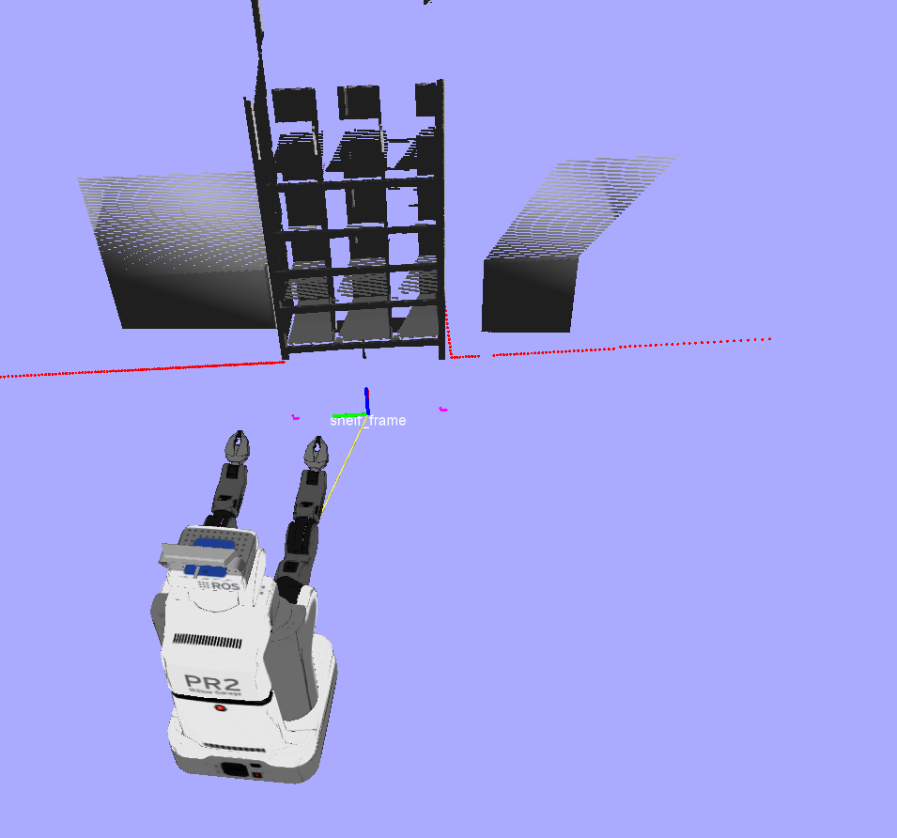
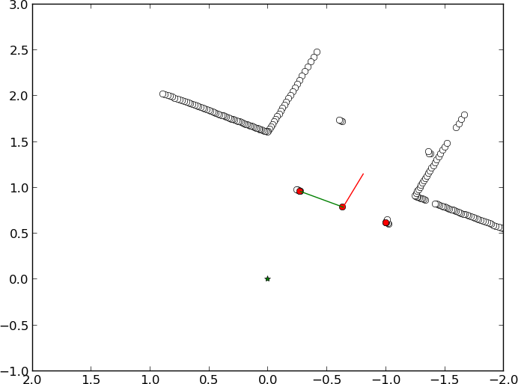
The Key of Our System
Shelf Localization
Front legs based
Triangulate legs and the base_laser_link
Position and orientation
Human confirm to initialization
Prior updating
Remember and update the pose of legs
Insensitive to noise
Recovery from occlusion
File stream for hot backup

Slide 4
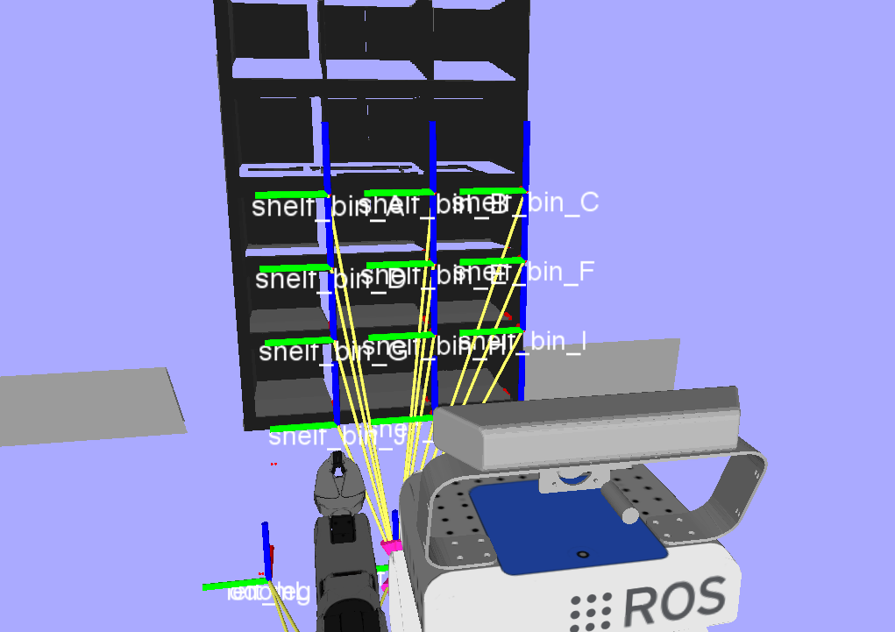
Knowing the location of the shelf
Position of each bin is known
Define navigation waypoints to reach the shelf
Define perception/manupulation waypoints to move the arm in front of each bin
Only the last step of grasping involves some kind of reasoning

Slide 5
Strategy
Order bins by number of objects
Pick first object on the list
Move the robot to the desired bin
Find the object in the bin
Pick the object
Drop the object

Slide 6
Modules
Detection
Fuse camera, kinect ,laser scanner
Grasping
Reach Bin
Manipulation
Move the base
Decision
Provide Next object to grasp
Provide Position x,y,z
Compute a motion plan for the arm (MoveIt!)
Move the arm
Try different grasps
Decide whether to remove or postpone a dropped object.

Slide 7
Behavioral trees
Easy to code
Execute External ROS nodes (C++ or Python)
Each Module should be standalone (i.e. know when to start and report if it has succeeded or not).

Slide 8
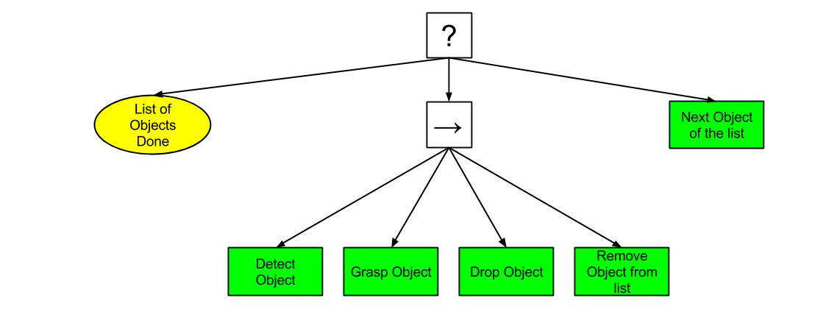
First Design

Slide 9
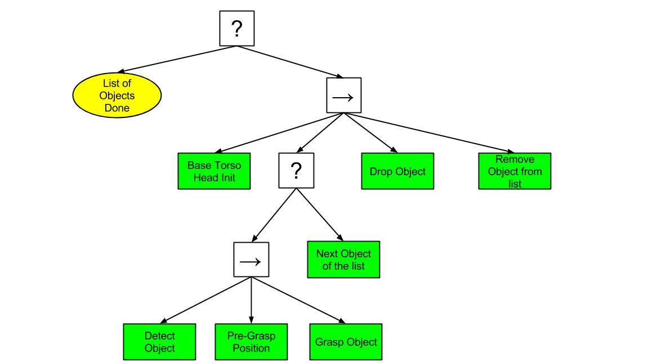
Final Design

Slide 10
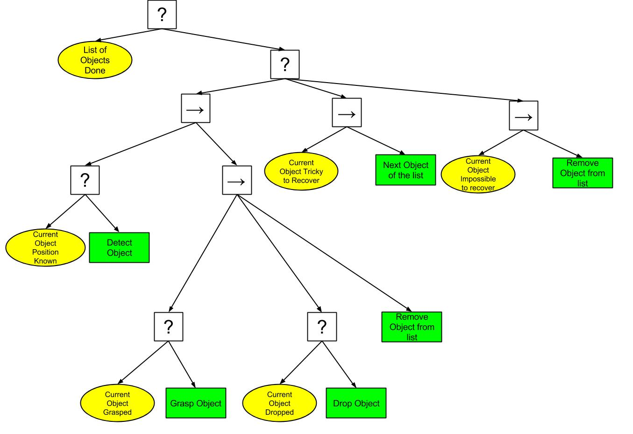
Ideal Design

Slide 11
Perception
2 steps procedure
Object detection using Simtrack
Cloud clustering to find potential unrecognized objects

Slide 12
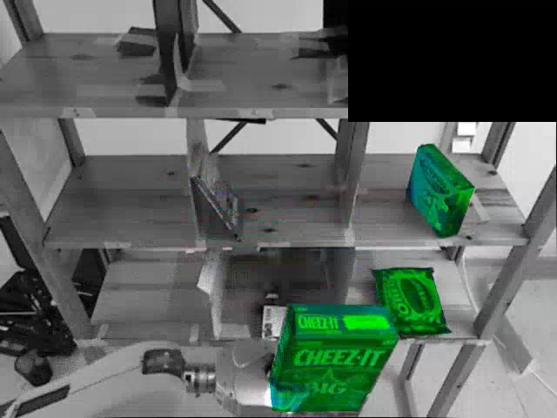
Simtrack Imax

Slide 13
Building the Point Cloud of the Bin
Shelf localization to find position of the right bin
Cloud built using Kinect and tilt laser
Crop the cloud to have points inside the bin boundaries (tuned manually)

Slide 14
Segmentation of Objects
Iterative Euclidean clustering to fit the known number of object in the bin
Discard small clusters
Discard floating clusters

Slide 15


The Strategy
Simtrack recognizes the right object to pick
Pick the object
10 points in single bin
15 points in double bin
20 points in others

Slide 16

The Strategy in double bin item
Simtrack recognizes the other object to pick
Segmentation finds 2 clusters
Pick the unknown cluster

Slide 17
The Dirty Strategy
Simtrack does not recognize the object to pick
Segmentation finds as many clusters as the objects in the bin
Number of unknown clusters <= 2
Pick all the clusters
10 points in single bin
3 points (15 - 12) points in double bin
8 points (20 - 12) in other bins

Slide 18
Grasping
7 steps:
Object detection (SimTrack + Segmentation)
Pre-grasping (posing gripper in front of the bin)
Reaching (reach the grasping point, i.e. object center)
Grasping
Prepare for retreat (lifting + centering in bin)
Retreat (drive the robot backwards)
Dropping

Slide 19
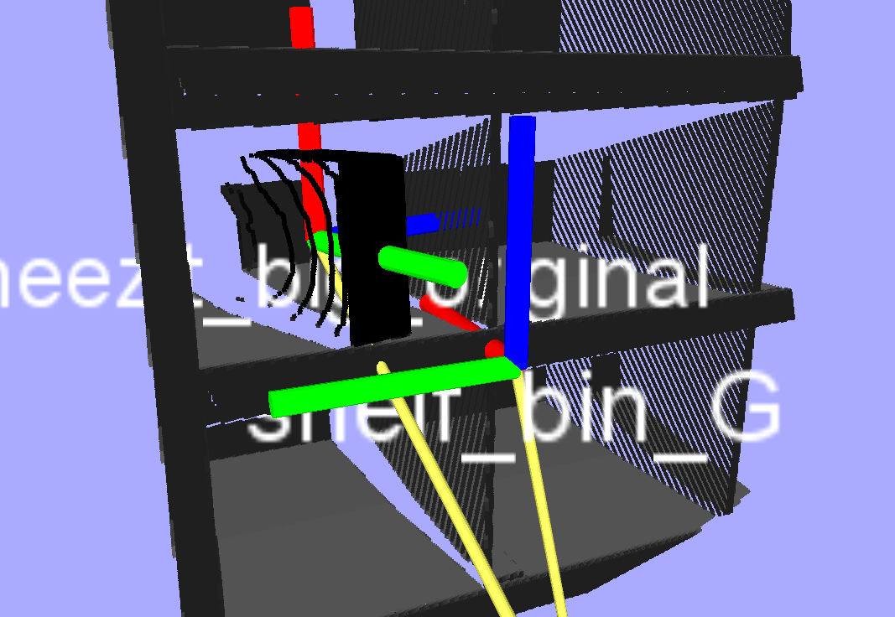
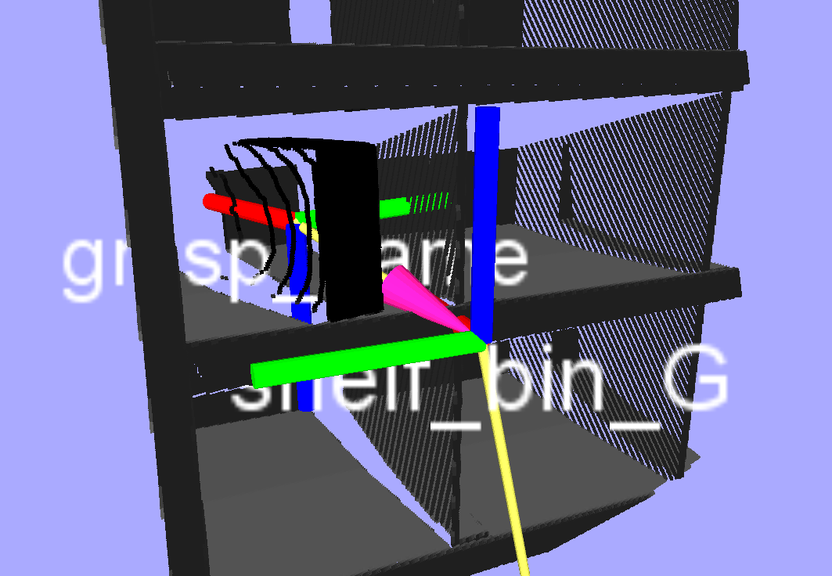
Grasping
Grasping Frame:
Based on detected object frame
Projected such that:
X: inward
Y: point to right
Z: downward
Consistent frame for specifying grasping motion
MoveIt receives grasping poses expressed in this frame only
object_frame
grasping_frame

Slide 20
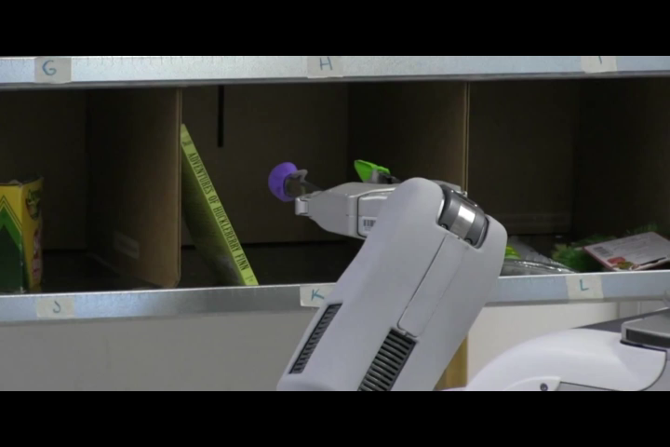
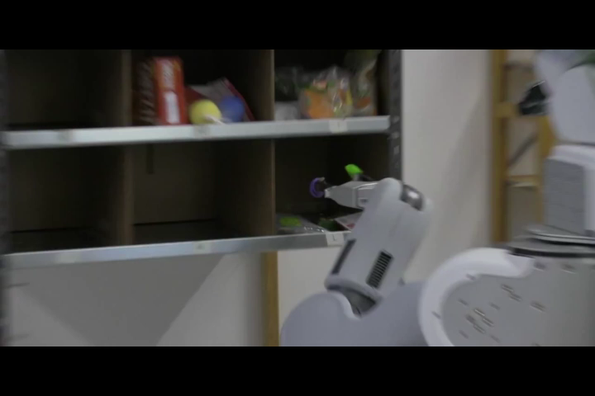
Grasping
Side-grasping:
Yaw: allow +- 15 degrees freedom
Roll: always 0
Pitch: always 0
Reaching distance: grasping dictionary based
Top-grasping:
Yaw: +- 15 degrees freedom
Roll: always 0
Pitch: 15 – 45 degrees
Touching: grasping dictionary based
Grasping dictionary:
Objects dimensions
Graspable faces
Detection methods
Top/Side grasping

Slide 21
PR2 Limitations
Torso is very slow to raise
Hand is very large
Cannot reach the top level
Cannot grasp wide or flat objects

Slide 22
What went wrong in Seattle
PR2 provided by Clearpath
Little time to calibrate it
Lighting condition

